Slide 1

Spring AI
The Spring AI project aims to streamline the development of applications that incorporate artificial intelligence functionality without unnecessary complexity.
Spring AI offers a wide array of tools and APIs.
These tools ensure modularity, interchangeability, and ease of integration for diverse AI development needs.

Slide 2

Tools
Chat Completion API
Embeddings API
Image Generation API
Transcription API
Vector Databases
Function Calling API
Prompts
Output Parsers
ETL Pipeline
Generic Model API

Slide 3
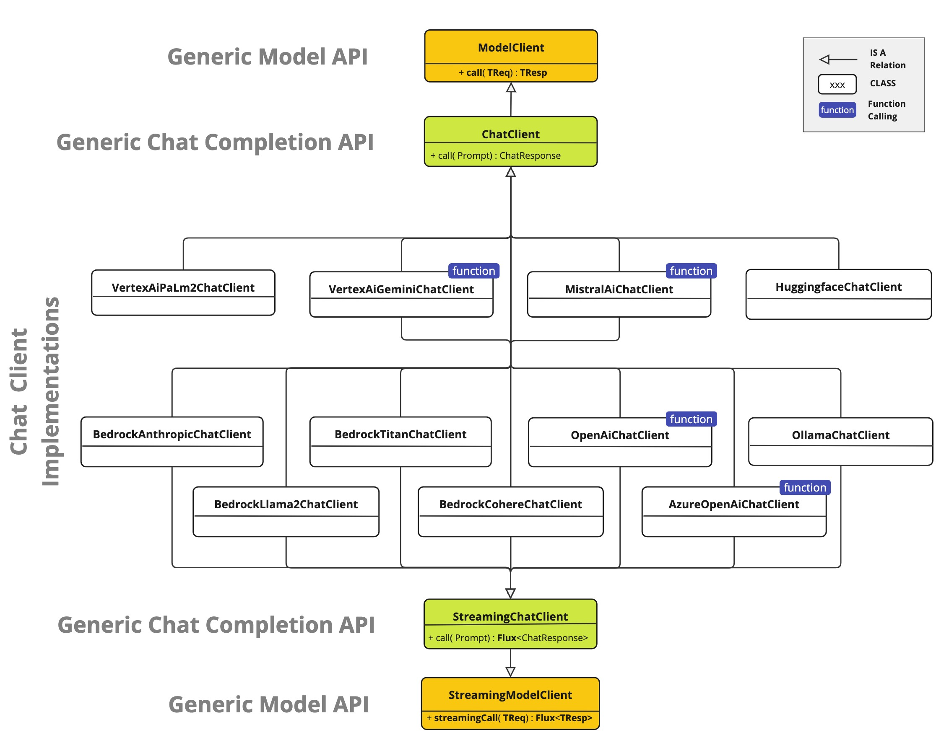
Chat Completion API
Integrate AI-powered chat capabilities using pre-trained language models.
Simpliﬁes the interaction with various AI models.

Slide 4
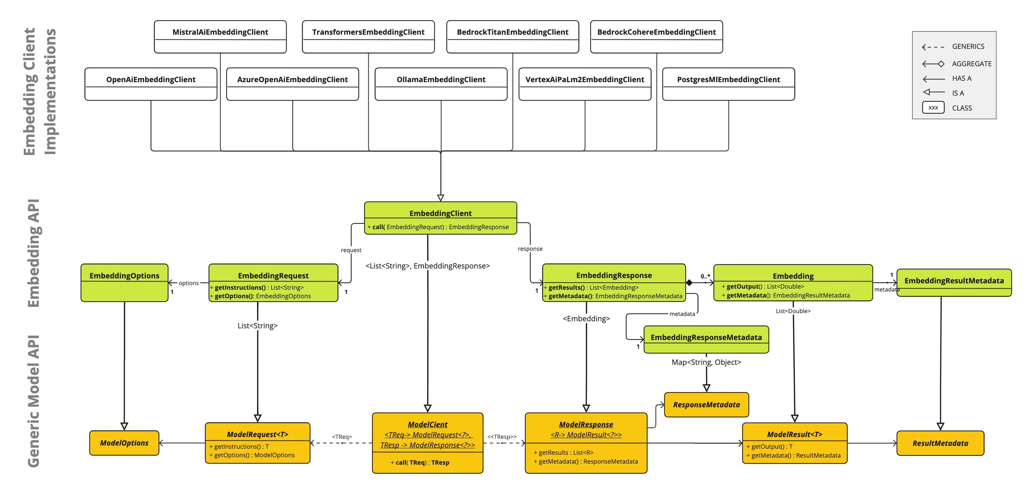
Embeddings API
Facilitates integration with embedding models.
Converts text into numerical vectors.

Slide 5

Image Generation API
Provides an interface for interacting with AI models specialized in image generation.
Allows switching between diﬀerent models with minimal code changes.

Slide 6
Transcription API
Supports the process of transcribing audio content.
Enables easy integration of speech recognition capabilities into applications.

Slide 7

Vector Databases in AI
Crucial for AI applications, enabling similarity searches and data integration with AI models.
Oﬀers a versatile interface for multiple vector database implementations.

Slide 8

Function Calling API
Allows AI models to request the execution of client-side functions.
Enables dynamic tasks and information access.

Slide 9
Prompts in AI
Guides AI models in generating specific outputs.
Introduces higher levels of abstraction for advanced constructs.

Slide 10
Output Parsers
Can transform AI model output into structured data.
Enhances usability and integration into applications.

Slide 11
ETL Pipeline
It serves as the data processing foundation for the Retrieval Augmented Generation (RAG) use case.
Optimizes data format for AI model retrieval.

Slide 12

Generic Model API
Serves as the cornerstone for all AI Model clients.
Oﬀers a standardized pattern for contributing new AI Model support.

Slide 13

Conclusion
Spring AI provides a comprehensive suite of tools and APIs for diverse AI application development needs.
Thank you for your attention.
GitHub Project: https://github.com/jeremykittel/spring-ai
Spring AI: https://spring.io/projects/spring-ai

